Slide 1

HASS 101|ACADEMIC AND COMMUNICATION SKILLS|WEEK 3
Listening and note-taking
Hearing is a spontaneous act. Listening, by contrast, is something you choose to do.
Active listening · Cornell notes · Soprano technique · Mind maps · Sketchnotes
Academic writing and communication skills
Notes:
Welcome. This session has two parts: first how to LISTEN actively, then how to turn what you hear and read into useful NOTES. About 2 hours with a break after 50 minutes.

Slide 2




TODAY'S PLAN
What you will be able to do
Tell hearing from listening
Use active listening skills
Understand why listening is a choice, not an accident.
Eye contact, nodding and clarifying questions in real conversations.
Apply note-taking systems
Reflect and improve
Cornell, Soprano, mind maps and sketchnotes, and when to use each.
Review your own notes and habits, then decide what works for you.
Part 1: Listening skills Part 2: Note-taking systems
Notes:
Read the four outcomes aloud. Point out that Part 1 is listening and Part 2 is note-taking systems.

Slide 3


PART 1 · LISTENING
Hearing vs. listening
Hearing
Listening
Spontaneous: it just happens
Sound reaches your ears
No effort or understanding needed
Example: traffic noise while you study
A choice you make on purpose
You hear AND understand
Needs attention and effort
Example: following the main points of a lecture
Listening
=
Hearing
+
Understanding
+
Focus
Notes:
Warm-up game: play a 30-second audio twice. First time students write what they heard. Second time they listen for meaning. Ask what changed.

Slide 4
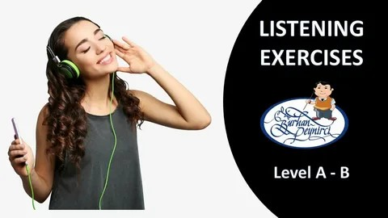



PART 1 · LISTENING
Understanding requires three activities
Dynamic listening
Stay mentally active: predict the next point, ask yourself questions, link ideas.
e.g. "Three causes? What might they be?"
Paying attention
Give the speaker your eyes and mind. Phone away, distractions ignored.
e.g. notes ready, phone in bag, eyes up
Best way to concentrate: start with anticipation, before the lecture begins.
Concentration
Hold your focus for the whole session. Start with anticipation.
e.g. reread last notes, do the reading first
Notes:
Explain each with a quick example. Emphasize that concentration begins before class, with anticipation.

Slide 5



PART 1 · LISTENING
Be a comprehensive listener
The speaker
The listener
Must make words comprehensible: clear structure, examples, and a check on your listeners' faces.
Must let the speaker know when something is unclear: ask questions and use facial expressions.
feedback
50/50, but 100% each. Both sides must give their full effort for understanding to happen.
"The only dumb question is the one that goes unasked."
Notes:
Comprehensive listening is a feedback loop. Stress that asking questions is a sign of engagement, not weakness.

Slide 6


ACTIVE LISTENING
Three techniques that show you are listening
Maintain eye contact
Nod and respond
Ask clarifying questions
Shows attention and builds trust
Shows you are following
Fills gaps and avoids misunderstanding
Look at the speaker, not your phone or the room.
Small nods plus "I see" or "Yes" keep the speaker going.
Rephrase, ask for detail, or ask an open question.
Listening is not passive. We show it with body language and curiosity.
Notes:
Introduce the three techniques. Ask students which one they use most naturally.

Slide 7


ACTIVE LISTENING · 1
Maintaining eye contact
50%
70%
4–5 s
of the time while you are speaking
of the time while you are listening
hold eye contact, then look away briefly
The 50/70 rule in numbers
Shows attention
Builds trust
Reads emotions
You look at the speaker, not at your phone or around the room.
It signals sincerity and creates a sense of mutual understanding.
Your eyes pick up nonverbal cues that words alone do not show.
Cultural note: eye-contact norms vary. Adapt respectfully.
Notes:
Teach the 50/70 rule. Model it yourself while students speak. Remind them that eye-contact norms differ across cultures.

Slide 8
ACTIVE LISTENING · 2
Nodding and small responses
Nodding in action
Why nod?
Speaker: "The deadline moved to Friday, so we need the draft by Thursday."
Affirms understanding: you are following and processing.
Expresses agreement: a quick or slow nod says "I'm with you".
Encourages the speaker: creates a positive feedback loop and helps them relax.
Listener: *nods slowly* "I see. Thursday, got it."
Verbal affirmations:
Tip: a nod means "I'm following", not always "I agree". Pair it with eye contact and keep it natural.
I see
Yes
Right
Go on
Notes:
Demonstrate nodding with a student volunteer. Practice the small verbal affirmations in pairs.

Slide 9




ACTIVE LISTENING · 3
Asking clarifying questions
Confirm
Fill in details
Go deeper
Rephrase or summarize to check accuracy.
Ask directly when a key piece is missing.
Open questions invite detailed answers.
"If I'm understanding you correctly, you're saying that…"
"What did you mean when you said…?"
"Tell me more about…" / "How did that happen?"
Respectful
Accusatory
"I want to be sure I understood. Could you go over the second point again?"
"You didn't explain that clearly." (Admit you need more information instead.)
Notes:
Have students rewrite two accusatory questions into respectful ones. Point out that open questions start with how, what, or tell me more.

Slide 10
PART 1 · LISTENING
Twelve guidelines for effective listening
1
2
3
4
Sit where the instructor can see you, ideally at the front.
Judge the material, not the lecturer's appearance or delivery.
Put emotions aside. Hold your disagreement until after class.
Listen for ideas, not just facts and words.
5
6
7
8
Aim for a good written record. Be a flexible note-taker.
Watch for signals and examples. Mark them "EX".
Read ahead and link the topic to something you care about.
Challenge your mind. Stay open even when words are emotional.
9
10
11
12
Prepare questions. Use facial expressions to show confusion.
Keep listening through discussions, until the very end.
Work at listening, instead of pretending to listen.
Resist distractions: latecomers, noise, side talk.
Notes:
Do not read all twelve. Ask students to pick the two they find hardest, then discuss.

Slide 11
PRACTICE · ACTIVE LISTENING
Mystery Speaker challenge
Pair up
Example round (topic card: "Your favourite food")
1
Student A gets a secret topic card.
Student A: It's warm, round, and usually shared with friends.
Describe
Student B: How big is it? Is it sweet or savory?
2
A describes the topic without naming it.
Student A: Savory. It has a crust and cheese on top.
Listen & ask
3
B asks 2–3 clarifying questions, then guesses.
Student B: If I'm understanding you correctly, you eat it in slices. Is it pizza?
Switch
Student A: Yes! You got it.
4
After 2 minutes, swap roles.
Tip: time each round, and give a small prize to the best listener.
Notes:
10-15 minutes. Pairs. Students A and B swap roles after 2 minutes. End with the three reflection questions on the next slide.

Slide 12

PRACTICE · ACTIVE LISTENING
Mystery Speaker: topic cards
Your dream holiday destination
Your favorite movie
A pet you love or would like
A hobby you enjoy
Your favorite food
A place you want to visit
A person who inspires you
Your weekend plans
A childhood memory
Your dream job
A sport you like
A book you recently read
Your favorite season and why
A funny or strange experience
Your favorite teacher or class
Reflect together
What helped you understand your partner's topic?
What did your partner do that made you feel listened to?
How did you show that you were actively listening?
Notes:
Cards can be printed and cut out. Students may swap cards for a second round.

Slide 13


PART 2 · NOTE-TAKING
The challenge of lectures
Information goes by once
Hard to spot what matters
If you miss something because you were writing, it's gone.
Main points and secondary points sound alike at speed.
The solution: treat a lecture as a three-part experience
BEFORE
DURING
AFTER
Prepare and anticipate
Listen actively, use a system
Review and respond
Notes:
Lecturers condense years of reading into 50 minutes. Two problems: information goes by once, and it is hard to tell main points from secondary ones.

Slide 14






NOTE-TAKING · BEFORE
What to do before the lecture
Read the syllabus
Recall what you know
Review last notes
Check the lecture title. Where does it fit in the course?
Predict what might be covered.
Re-establish the context of the course.
Do the readings
Get the handouts
List your questions
Anticipate how they connect to the lecture.
Print posted slides or key-term lists to annotate.
Write what you want the lecture to answer.
Example: Lecture "Time Management for Students". Predict: planning, priorities, procrastination. Question: "Which tool works best for a busy week?"
Notes:
Anticipation activates prior knowledge, so the lecture becomes easier to follow.

Slide 15
NOTE-TAKING · DURING
Listen for cue words
Type of cue word | Examples | What to do
Signal emphasis or importance | essential, crucial, significantly | Star it and write it down
Signal order or scope | first, second, third; initially, finally; for instance, for example | Number it, note the example (EX)
Signal a new direction | however, nonetheless, whereas, in contrast | Start a contrasting note
Signal NOT central | incidentally, as a digression, by the way | Skip it, no need to write
Cue words help you cluster and prioritize information as you listen.
Notes:
Read each example aloud in a sentence. Ask students what they would do with their notes when they hear it.

Slide 16
NOTE-TAKING · DURING
Know what to write down
Write down
Build your shorthand
New or unfamiliar facts and ideas
because
b/c
with / without
w/ w/o
Lists: the lecturer's categories, reasons, themes
leads to
→
The lecturer's reasons for favouring a theory
not equal
≠
example
EX
Points the lecturer pauses over or repeats
important
★
compared to
vs
NOT what's on a slide you can get later
increase / decrease
↑ ↓
Notes:
Explain that repeated points and lists are strong clues. Show the shorthand table and let students invent two of their own.

Slide 17
NOTE-TAKING · DURING
Good notes: short, accurate, useful
Don't write everything; capture the "meat"
Key words or very short sentences
Your own words, same meaning
Think before you write
Consistent abbreviations and indented outline
Leave white space for later additions
Missed a point? Leave a gap and fill it in later
Keep notes in one place, in order
Lecturer says: "Time management is important for students because if you plan your week, you reduce stress and hand in work on time."
Too much
The lecturer said time management is important for students because if they plan their week they will reduce stress…
Better
Time mgmt: plan wk → ↓ stress, work on time ✓
Notes:
Give students the lecturer sentence and ask them to write a note in 10 seconds. Compare with the two examples.

Slide 18
SYSTEM 1 · CORNELL METHOD
The Cornell method: set up the page
1
Draw the lines
A vertical line about 2½" from the left edge, and a horizontal line about 2" above the bottom.
2
Right column: notes
CUES /
QUESTIONS
Take lecture notes in point form during class.
NOTES
lecture notes in point form
Left column: cues
3
Add key terms or questions after class. Keep most of it blank at first.
4
Bottom: summary
SUMMARY
Summarize the whole page in your own words.
2–3 sentences in your own words
Notes:
Draw the layout on the board first. Right column = notes, left column = cues, bottom = summary. It also works on lined paper: ignore the red margin and draw your own line.

Slide 19



SYSTEM 1 · CORNELL METHOD
Cornell notes in action
Time Management for Students · ENG 102 · 12 Oct
Write the cues after class
Why plan?
3 planning tools?
What is procrastination?
Priority rule?
Planning → ↓ stress, work on time
Tools: to-do list, weekly planner, calendar app
Procrastination = delaying despite consequences; fix: 25-min blocks
Do urgent + important first ★
EX: Sara plans on Sunday → no all-nighters
Turn each note into a question.
Cover and self-test
Hide the notes, answer from the cues.
Summarize last
Summary: Time management means planning tasks by priority so work is finished calmly and on time. Simple tools and short focus blocks make it easier.
Use your own words, not a copy.
Notes:
Walk through the sample page. Ask: which cue would help you recall each note? Then show how to self-test by covering the notes column.

Slide 20
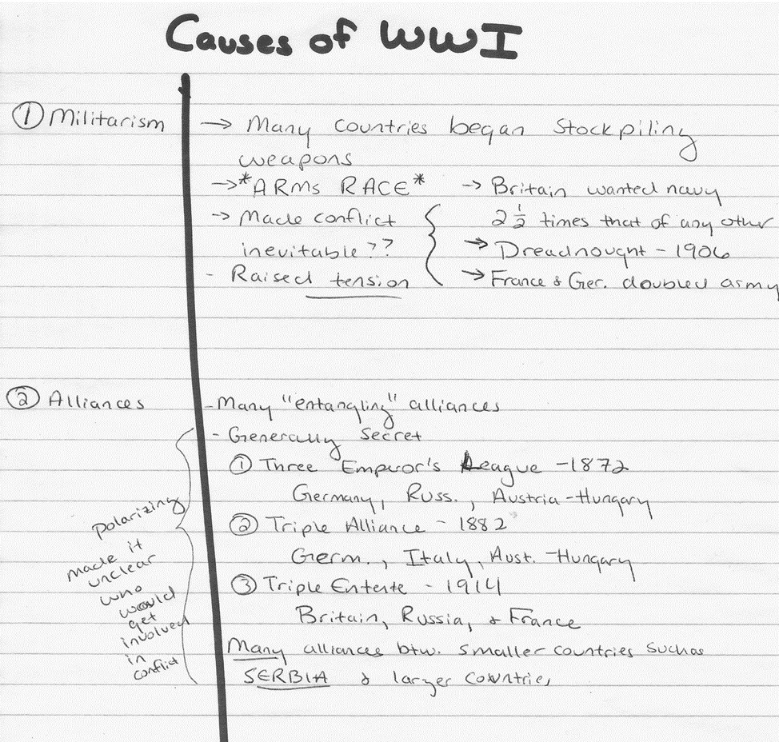

SYSTEM 1 · CORNELL METHOD
A real Cornell page: what to notice
What to notice
Left column: numbered topics (1 Militarism, 2 Alliances) act as cues
Right column: short notes, arrows and key dates, not full sentences
Stars, underlines and brackets mark what matters most
Margin comments add your own thinking ("polarizing")
Learn more
Cornell notes video:
youtu.be/OPnQGLdeOnA
Notes:
Show the handwritten page (Causes of WWI). Ask students to find the cues, the arrows, the stars and the margin comment. Point out that the topics on the left work as recall cues.

Slide 21
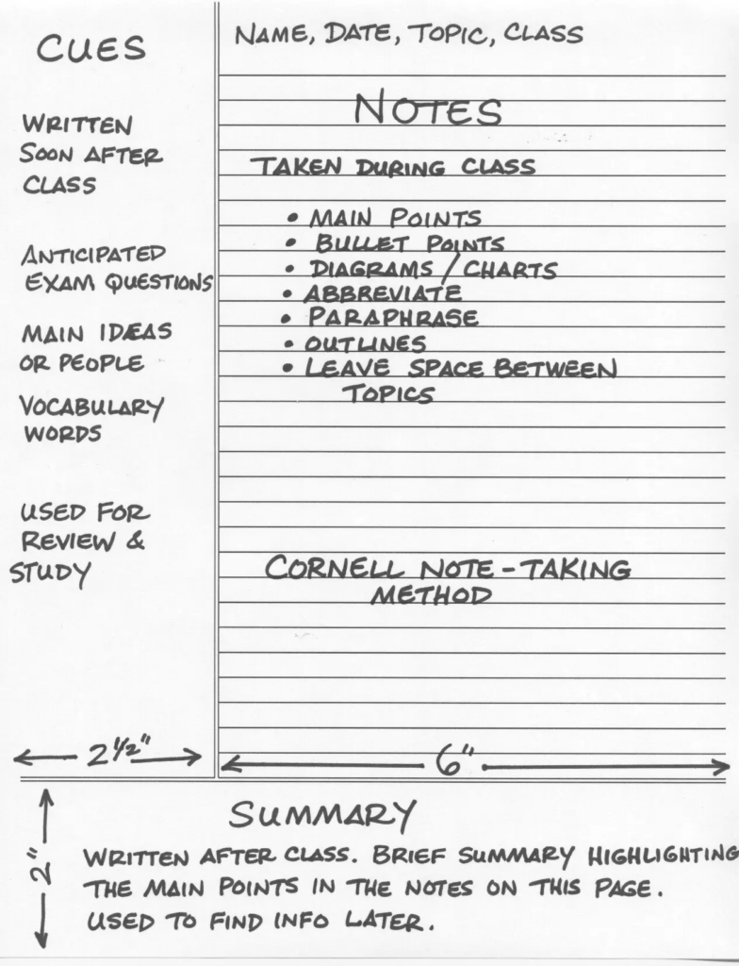

Slide 22






SYSTEM 2 · SOPRANO TECHNIQUE
The Soprano technique: 6 steps
1
Read
2
Decide
3
Mark
Read one paragraph at a time. Pen and highlighter down.
Ask: "Is this really important? Does it support the main topic?"
Highlight or underline key words, or write key-word notes in the margin.
4
Number
5
Question
6
Repeat
Put a number in the margin. Ascending order shows importance.
Copy the number and page to your notebook. Write a question the highlight answers.
Move to the next paragraph and keep numbering and questioning.
Soprano vs SQ4R: try both methods, then keep the one that works best for you.
Notes:
Use it for textbook reading. Distribute a short paragraph and walk through each step. Mention SQ4R as an alternative and let students try both.

Slide 23
SYSTEM 2 · SOPRANO TECHNIQUE
Soprano example 1: The importance of sleep
Paragraph (highlighted)
# | Key point | Your question
1 | Sleep is vital for health | Why is sleep important for health?
2 | Lack of sleep harms focus and memory | What problems does lack of sleep cause?
3 | Adults need 7–8 hours | How many hours do adults need?
4 | Routine and no devices help | How can we improve sleep quality?
Sleep plays a vital role in maintaining both physical and mental health [1] . During sleep, the body repairs tissues, strengthens the immune system, and supports brain function. Lack of sleep can lead to problems such as poor concentration, weakened memory, and increased stress [2] . Research shows that adults need about seven to eight hours [3] of sleep each night to perform well during the day. Creating a consistent bedtime routine and avoiding electronic devices before sleeping can significantly improve sleep quality. [4]
Your highlights may differ. No two people's notes should look the same. That is what makes you an active learner.
Notes:
Students highlight in pairs first. Compare: no two sets of notes look the same, and that's fine. Sample answers are a guide only.

Slide 24
SYSTEM 2 · SOPRANO TECHNIQUE
Soprano example 2: Technology and sleep
Paragraph (highlighted)
# | Key point | Your question
1 | Blue light lowers melatonin | What does blue light do to melatonin?
2 | Slower, lighter sleep | How does it affect sleep quality?
3 | No screens 1 hour before bed | What can people do to sleep better?
Using electronic devices before bed can negatively affect sleep quality. The blue light from phones, tablets, and computers reduces the production of melatonin, a hormone that helps people fall asleep. [1] As a result, many people take longer to fall asleep and experience lighter sleep throughout the night. [2] Experts recommend avoiding screens at least one hour before bedtime and choosing relaxing activities like reading or listening to calm music instead. [3]
Self-test: cover the paragraph and answer each question. The highlighted text should answer it.
Notes:
Repeat the process with the second paragraph. Then use the reflection questions from the worksheet: what was easy or hard about deciding what to highlight?

Slide 25
SYSTEM 3 · MIND MAPPING
Mind mapping: see the big picture
A visual note-taking method: one central idea, with branches for related ideas.
Eye contact
50/70 rule
Nodding
"I see" · "Yes"
1
Write the central idea in the middle
Active
listening
2
Draw a main branch for each big idea
3
Add sub-branches with key words only
4
Use colors, symbols and small images
Clarifying Qs
confirm · detail
Focus
phone away · front
Best for: brainstorming, revision, seeing links
Notes:
Have students draw a mind map of today's lesson in two minutes using three colors. Compare maps and notice different structures.

Slide 26









SYSTEM 4 · SKETCHNOTING
Sketchnoting: notes with pictures
Doodles and icons
a moon for sleep, a bulb for an idea
SLEEP & LEARNING
Containers
boxes, banners, clouds around key ideas
Connectors
arrows show cause and effect
Lettering
7–8 hours
memory + focus
better results
big headers, small body text
Dividers
Key idea: sleep locks in what you learned
lines and bullets keep order
Listen first, draw second. Keep it simple.
Notes:
Reassure students: simple shapes and stick figures are enough. Show one real sketchnote if you have one. Listen first, draw second.

Slide 27
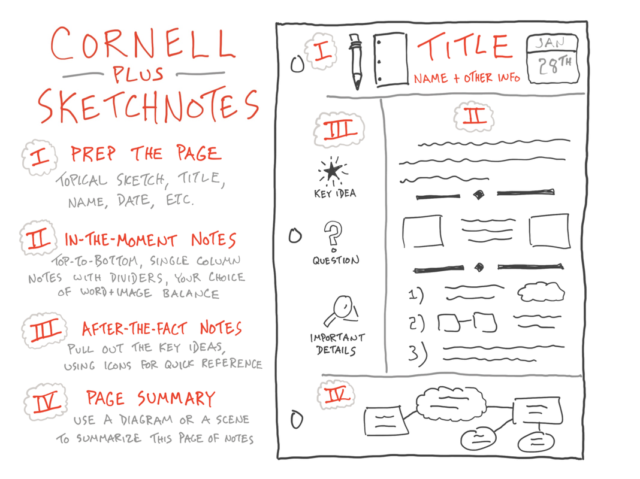

Slide 28
COMPARING SYSTEMS
Which note-taking method should you use?
Method | Best for | Strength | Watch out for
Cornell | Lectures | Organized; built-in review and self-test | Needs time to add cues and summary
Soprano | Textbook reading | Ranks importance; questions ready for exams | Slower than plain highlighting
Mind map | Brainstorming, revision | Shows links between ideas | Hard to follow a fast lecture
Sketchnote | Visual learners, talks | Memorable images and structure | Drawing can distract from listening
Tip: combine them. Cornell in class, a mind map to revise, a sketchnote for a key concept.
Notes:
There's no single best method. Ask students to vote for the one they will try this week and say why.

Slide 29
NOTE-TAKING · AFTER
After the lecture: review, don't file away
1
Read soon after
Review rhythm
Highlight main points, star key items, fill in gaps.
DAILY
2
Use the margins
quick re-read of today's notes
List terms on one side, add a short summary or a link to the readings on the other.
3
Talk it through
WEEKLY
Discuss notes with a friend or study group.
review all the week's notes
4
Make flashcards
Key terms with brief definitions: start early.
BEFORE A TEST
major review using cues and flashcards
5
File it properly
Course code, lecture title, date; keep in order.
Edit your notes; don't just copy them.
Notes:
Research shows we forget rapidly. Editing notes soon after is as important as attending the lecture itself.

Slide 30

PUT IT INTO PRACTICE
Active listening in discussions and lectures
In class discussions
In lectures
Look at whoever is speaking
Nod and use "I see" or "Right"
Paraphrase before you reply: "So you're saying…"
Ask open questions: how, what, tell me more
Hold your judgment; disagree politely after they finish
Sit near the front; phone away
Preview the topic and readings
Listen for cue words and repeated points
Mark examples with EX; note your questions
Ask the lecturer when you're lost
Challenge: pick two skills to practice this week and track how often you use them.
Notes:
Students choose two skills to practice this week and share them with a partner next class.

Slide 31






REVISION GAME · TEAMS
Find the mistake (1–10)
MYTH
Good listeners never ask questions.
You must write down everything in a lecture.
Note-taking and listening are the same skill.
The main idea is always in the first sentence.
Highlighting everything helps you study better.
Notes:
Teams have 10 seconds to correct each statement aloud. One point per correct answer. Cover the right column before revealing.

Slide 32


Reflect, then try it yourself
Reflection (3–4 sentences)
Homework
What note-taking strategy works best for me?
What can I improve about my listening?
Was it easy or hard to decide what to highlight? Why?
Watch the Cornell notes video
Take Cornell notes on a 5-minute TED Talk
Bring your notes to share next class
youtu.be/OPnQGLdeOnA
Notes:
Give 5 minutes for writing. Ask 3-4 volunteers to share. Explain the homework and share the video link.

Slide 33

KEY TAKEAWAYS
Two equations to remember
Active listening
Good notes
= focus + understanding + feedback
= short + organized + reviewed regularly
Good notes are your second brain!
Notes:
Close with the two equations from the lesson plan. Thank students and remind them of the homework.

Slide 34
"Sometimes it's the journey that teaches you a lot about your destination."
– Drake
Keep practising: every lecture is a chance to improve your listening and your notes.
Notes:
Closing quote taken from the original lesson deck.

